Slide 1
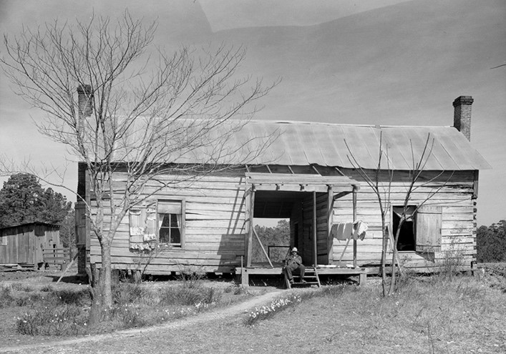
Feb. 21, 1940
“We lived on 110 acres in Pike County, Alabama. My father bought it for $300. Cash. It was every penny my father had to his name, money earned by tenant farming”
John Lewis is born, the son of Black sharecroppers near Troy, Alabama.

Slide 2
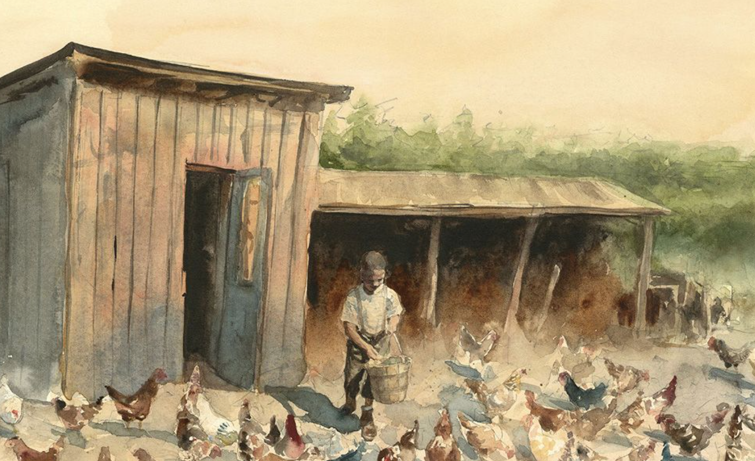
1945
“I was always drawn to the chickens. No one else could tell those chickens apart and no one cared to. I knew every one of them by appearance and personality.”
John Lewis’s main responsibility on the family farm was to take care of the chickens.

Slide 3
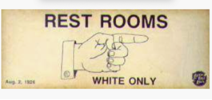
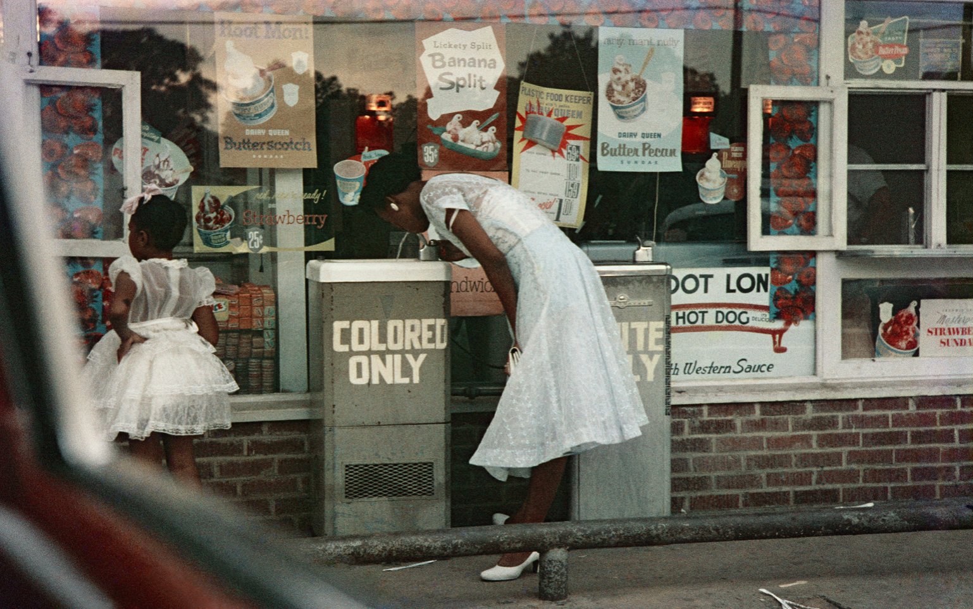
1951
“Stopping for bathroom breaks took careful planning. Uncle Otis knew which places along the way offered ‘colored’ bathrooms and which we were safer to just pass on by.”
John’s uncle Otis took him on his first trip North from Alabama, to Buffalo, New York.

Slide 4
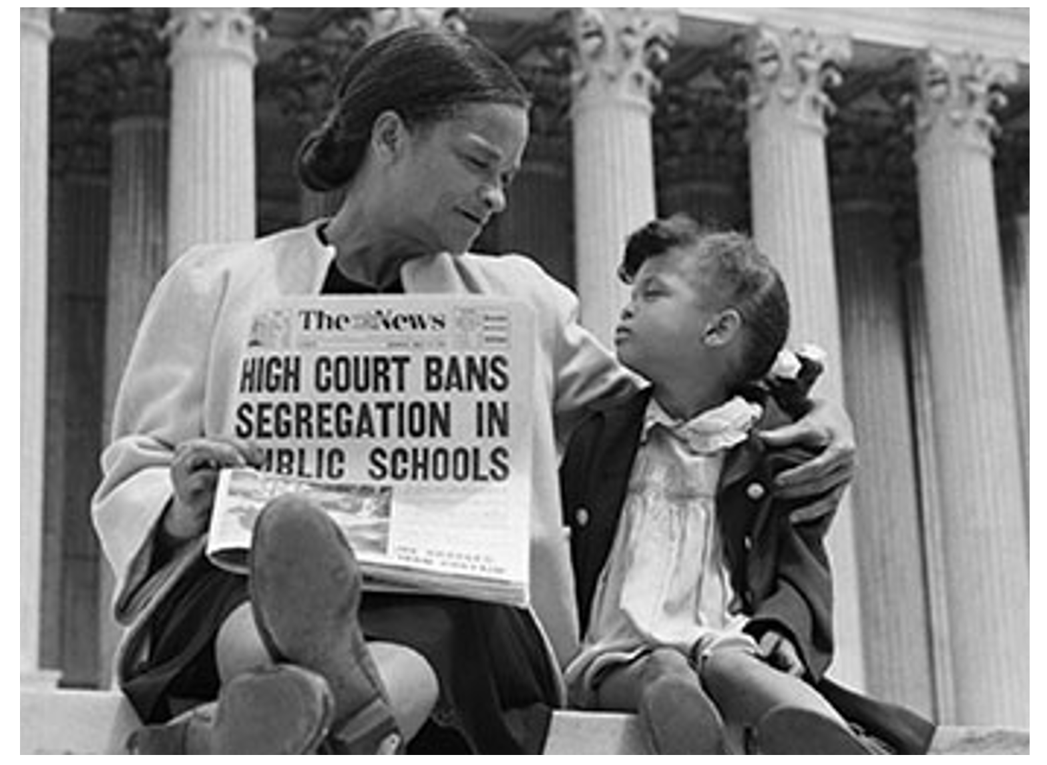
1954
“I was so excited. Surely everything was going to change. Come fall I’d be at a state-of-the-art school, an integrated school! But, not everybody was so excited.”
In Brown v. Board of Education, the Supreme Court declares that segregated schools are unequal and unconstitutional.

Slide 5
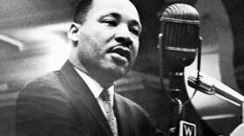
1955
“One Sunday in early 1955 I was listening to the radio when I heard a sermon by a young preacher from Atlanta. Dr. King’s message hit me like a bolt of lightning. He applied the principles of the church to what was happening now, today. It was called the social gospel and I felt like he was preaching directly to me.”
John Lewis heard a sermon by Dr. Martin Luther King Jr. on radio for the first time.

Slide 6
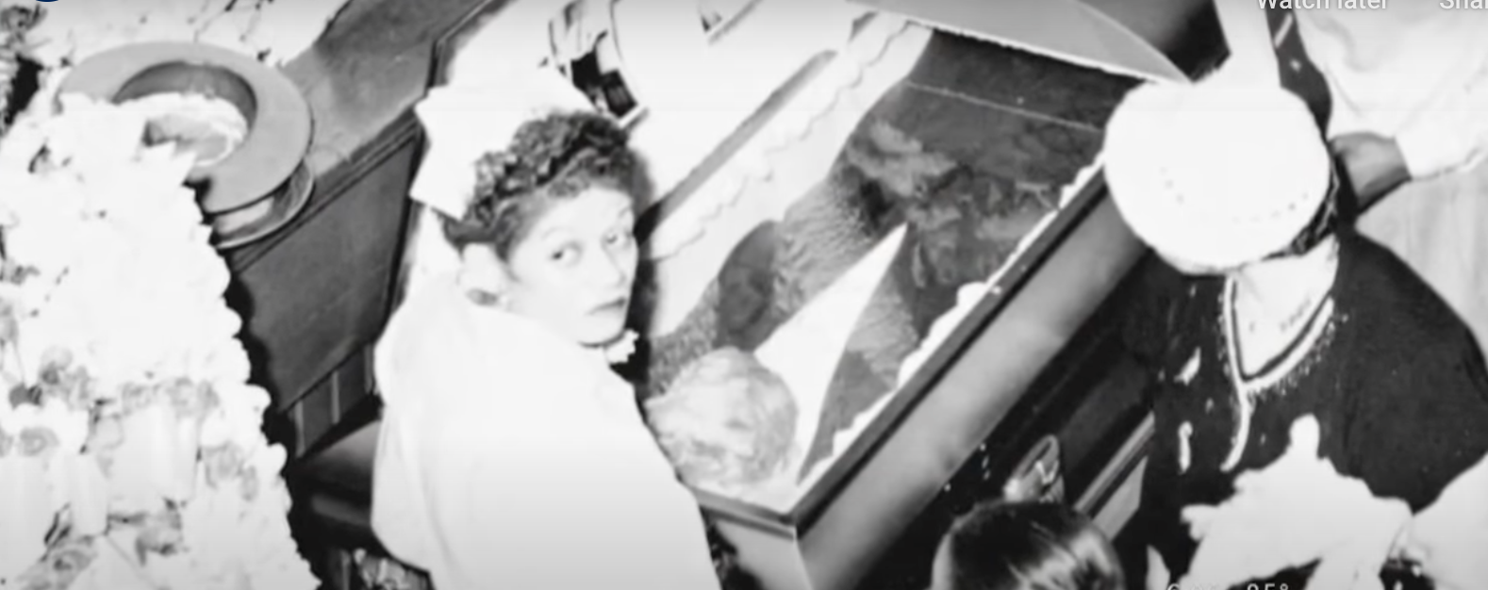
August 1955
“In August an incident occurred which no one could ignore. The body of 14-year-old Emmett Till was pulled from bottom of the Tallahatchie River. The day before as he left the money country store, he said “Bye, baby,” to the white woman behind the counter. The next day he was dead.”
Emmett Till was a fourteen-year-old African American boy from Chicago visiting family in the South. He was tortured and killed in Money, Mississippi after allegedly insulting a white woman.

Slide 7
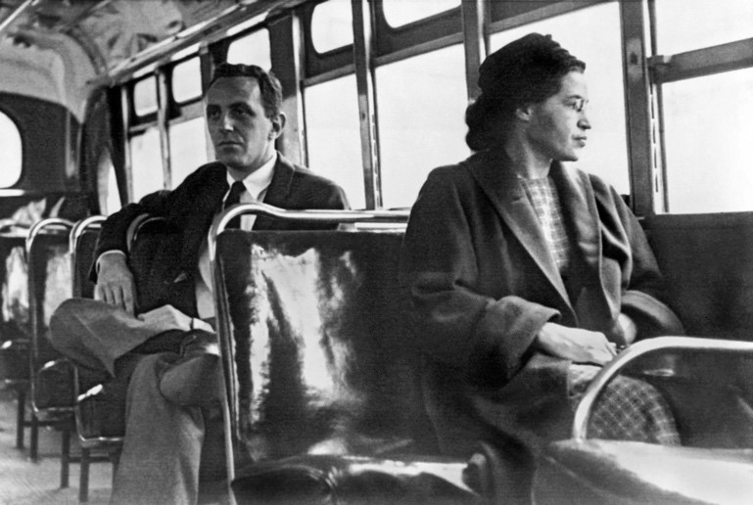
December 1, 1955
“My family didn’t know Rosa Parks but knew plenty of women like her. More than a few wives and mothers from [Pike] my home county did domestic work in Montgomery.”
Rosa Parks refused to move to the back of the bus and was arrested. This propelled the Montgomery Improvement Association (MIA) led by Dr. King, to start a boycott of buses in Montgomery.

Slide 8
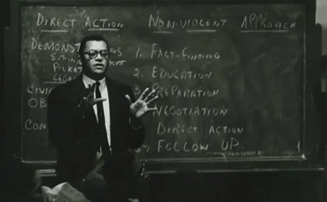
March 26, 1958
“Jim Lawson conveyed the urgency of developing our philosophy, our discipline, our understanding of non-violence. His words liberated me. I thought, this is it… This is the way out.”
John Lewis, now a college student, attends his first workshop on non-violence activism led by Jim Lawson, from a pacifist group (F.O.R. Fellowship of Reconciliation) which was committed to the philosophy and discipline of non-violence.

Slide 9
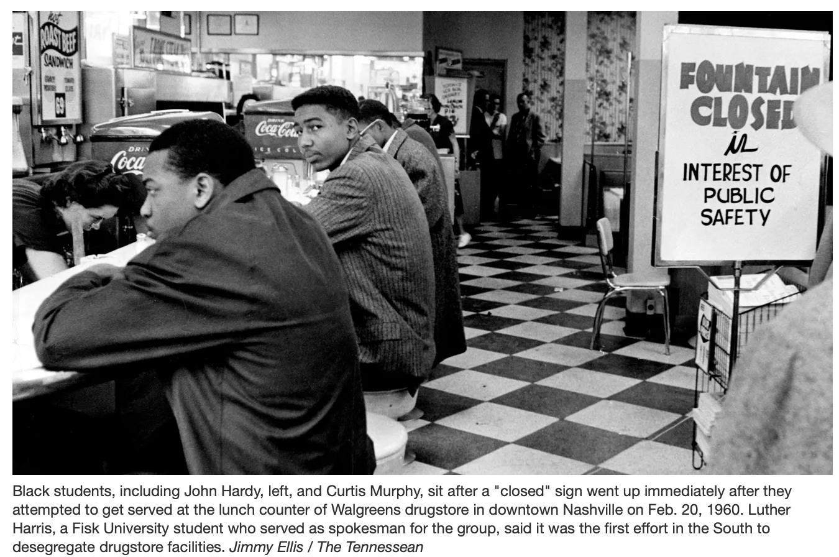
Fall 1959
“Segregation of the downtown stores bothered us the most. We could shop there and pay the same prices as white customers, but we couldn’t use the dressing rooms or sit at the lunch counters to eat. It was humiliating.”
Lewis partakes in lunch counter sit-ins in downtown Nashville, Tennessee to protest segregation in downtown businesses.

Slide 10
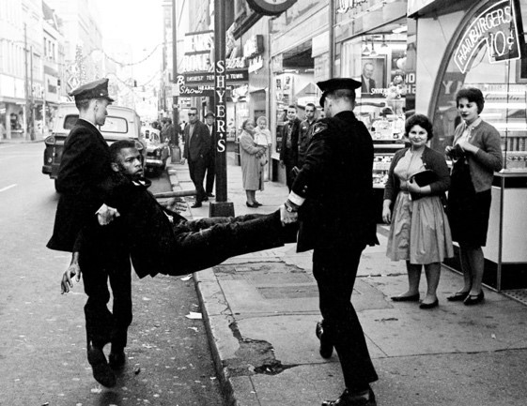
February 27, 1960
“We wanted to change America – to make it something different, something better. There were so many of us to arrest that as they drove us off to jail, we filled every paddy wagon the police had in Nashville.”
John Lewis’ first arrest. They went to jail singing “We shall overcome...” During the civil rights struggle, Lewis was arrested approximately 40 times.

Slide 11
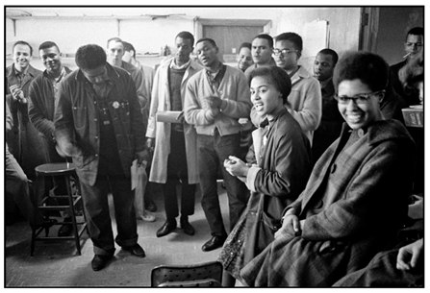
1960
“We must tap into our greatest resource. A people no longer the victims of racial evil who can act in a disciplined matter to implement the constitution.”
A group of student activists including Stokely Carmichael, and John Lewis found the Student Nonviolent Coordinating Committee (SNCC) to support voter education and to protest segregation.

Slide 12
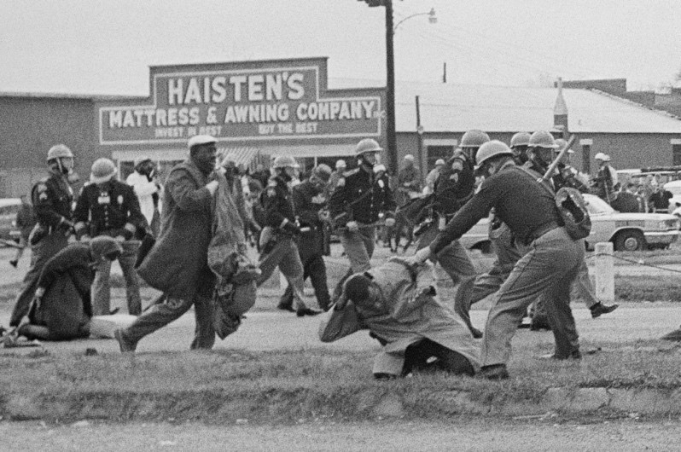
March 1965
"To those that have said, 'be patient and wait,' we must say that we cannot be patient. We do not want our freedom gradually, but we want to be free now. We are tired, we are tired of being beaten by policemen. We are tired of seeing our people locked up in jail over and over again, and then you holler, 'be patient.' How long can we be patient? We want our freedom, and we want it now."
Lewis and Hosea Williams lead an estimated 600 voting rights marchers out of Selma on the way to Montgomery. After crossing the Edmund Pettus Bridge, Lewis is beaten by an Alabama state trooper suffering a fractured skull. He spends two days in a hospital. The violent attacks were recorded and disseminated throughout the country, and the images proved too powerful to ignore. "Bloody Sunday" as the day was labeled, sped up the passage of 1965's Voting Rights Act.

