Slide 1
Illuminating Characters with Disabilities:
Good, Better, & Best Practices
AATE 2023 National Virtual Conference
JOHN NEWMAN * TALLERI McRAE* JEFF JENKINS

Slide 2
Preliminaries & Introductions
AATE Announcements
Accessibility Accommodations,
including Closed Captioning
Land Acknowledgments
Presenter Introductions
  John Newman, Utah Valley University
  Talleri McRae, National Disability Theatre
  Jeff Jenkins, Northwestern University
Participant Introductions in the Chat:
  Name
  Accessibility Needs
  A Favorite Story You Like to See Presented on Stage

Slide 3
ALL Audiences need some accommodations
Glasses and contact lenses
Supertitles for non-Italian speakers
Intermission (attention span, bladder span)
Announcement of performance length
Program to help us identify characters
Abridged text
Appropriate content for child and youth audiences
Accessible seating for family members
Choice of seating through general admission/website

Slide 4
ALL Actors need some accommodations
Rehearsal schedule posted
Text available in hard copy and/or soft copy
Personal space in rehearsal room and performance space
Lists of scenes posted backstage
Prompting during memorization process
Boundaries established and respected

Slide 5
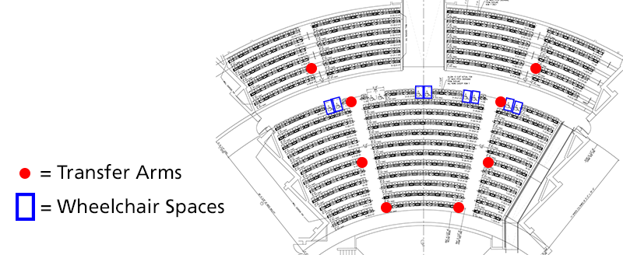
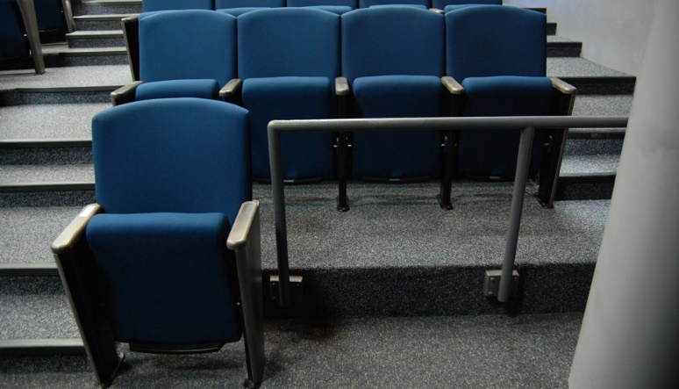
Goal: FULL Inclusion of Characters with Disabilities

Slide 6
Outline of Session
Presentation of a Model for Assessing Representation of Characters with Disabilities
Three Case Studies of Representation of Disabled Characters from the Panelists’ Work
  Jeff Jenkins: Timmon and the Magic Shoes
  John Newman: Romeo and Juliet
  Talleri McRae:
  Emily Driver’s Great Race through Space and Time
Collective Brainstorming: Presenting a Story on Stage

Slide 7
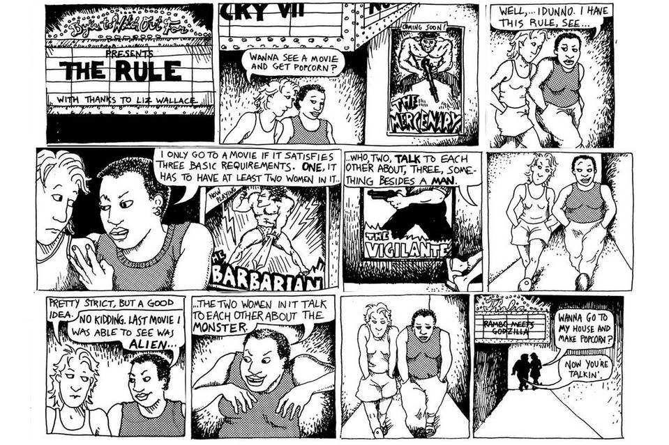
The Bechdel Test (1985, 2005) Alison Bechdel assessing female representation in movies
Does the movie include at least 2 [named] women?
Do the women talk to each other?
And do they talk about something besides a man?
(About half of commercial films pass the test; male leads still outnumber female leads 2 to 1)

Slide 8
The Fries Test (2017) Kenny Fries & Sherri Smith assessing representation of disabled characters in plays
  Does it have more than one disabled character?
  Do the disabled characters have their own narrative purpose other than the education and profit of a non-disabled character?
  Is the character’s disability not eradicated either by curing or killing?
  Additional Questions to Consider (National DisabilityTheatre)
  Do the disabled characters encounter conflicts or demonstrate characteristics unrelated to their disability?
  Do the disabled characters use their status, ability, and disability for positive and negative ends?
  Do the disabled characters both give and receive help from the non-disabled characters?
  How did the disabled community participate in the development, creation, and presentation of the play? (“Nothing About Us Without Us”)
  LINK TO NATIONAL DISABILITY THEATRE HANDBOOK (on site thru June 2024)
https://www.nationaldisabilitytheatre.org/ndt-handbook?fbclid=IwAR1DxdBIP55bohiH26-3v9FoV7YpeEsQAl23YC3fLRFUADTZSpYqqKfEzuo

Slide 9
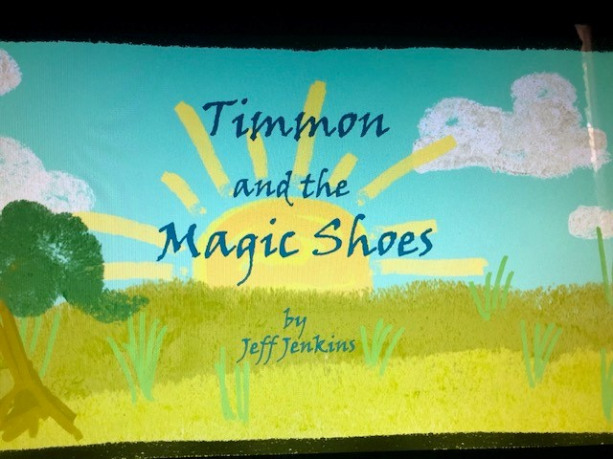
Jeff Jenkins
DEVELOPMENT, PRODUCTION OF
TIMMON & THE MAGIC SHOES at UVU
Synopsis: 4 characters with disabilities, (some visible some invisible disabilities)
-TIMMON giraffe (physical disability, i.e., a short neck)
-ADEDE -the grasshopper (unable to jump)
-KUMME – the wild dog pup (Visually impaired)
-DUME – Wild dog pup and packmate to Kumme (Has ADHD)
Notes:
Timmon and the Magic Shoes: Timmon, a hungry young giraffe with a penchant for trouble, wanders far from home in search of breakfast. Dangers lurk around every corner on the African Savannah as dogs and lions are out hunting. While in search of food, Timmon a giraffe born with a short neck meets a grasshopper (Adede) who can't jump, and a dog (Kumme) who is vision-impaired. They realize they are stronger if they work together. Soon they find food and struggle to reach the leaves in a tall tree until Kumme gives Timmon a pair of magic shoes to jump high and reach the leaves. In their excitement the three make too much noise calling a mean dog (Duma) to their location. The three survive by outsmarting Duma. By the end of the play the three for m a new pack and invite Duma to join them.
4 characters with disabilities, some visible some invisible disabilities
Several versions of the play, 10-miuute, Full-length small cast, Full-length large cast
Clip (3 characters) time stamp 40:00 -43:00
(A, T. K – discuss feeling different, reveal magic shoes)
Timmon giraffe (ohysical disability – short neck)
Adede ( -the grasshopper Physical disability, -unable to jump
Kumme – the wild dog pup (Physical disability -visual impairment)
Children were invited to join in the action during the play
Signers were used and recorded during the play. They appear in the lower left hand corner of the recording during the play.

Slide 10
Jeff Jenkins
DEVELOPMENT, PRODUCTION OF
TIMMON & THE MAGIC SHOES at UVU
Clip of Timmon and the Magic Shoes
(TIME STAMP 40:00 to 43:00)
Notes:
Timmon and the Magic Shoes: What happens when a giraffe with a short neck, a grasshopper who can't jump, and a dog who is vision-impaired meet unexpectedly. The play Tells the story of these three new acquaintances band together or will they let their differences continue to keep them apart?
4 characters with disabilities, some visible some invisible disabilities
Several versions of the play, 10-miuute, Full-length small cast, Full-length large cast
Clip (3 characters) time stamp 40:00 -43:00
(A, T. K – discuss feeling different, reveal magic shoes)
Timmon giraffe (ohysical disability – short neck)
Adede ( -the grasshopper Physical disability, -unable to jump
Kumme – the wild dog pup (Physical disability -visual impairment)
Children were invited to join in the action during the play
Signers were used and recorded during the play. They appear in the lower left hand corner of the recording during the play.

Slide 11
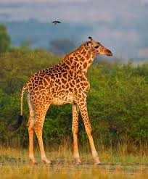
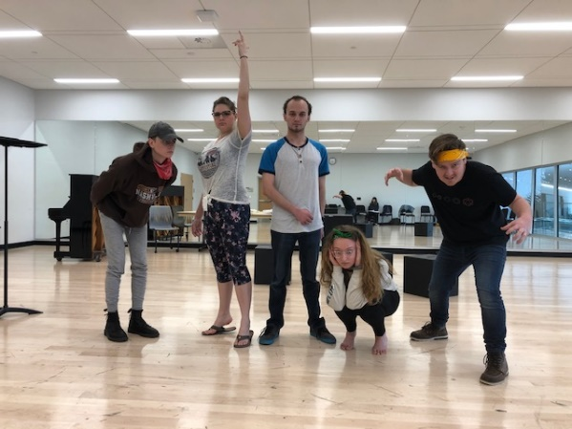
Jeff Jenkins
DEVELOPMENT, PRODUCTION OF
TIMMON & THE MAGIC SHOES at UVU
Development History
Impetus for the story -
Storytelling with son
May 2013 TYA/USA
(with/Write Local Play Global), (Winner) 10-minute version dir. Kim Peter Kovac. Cleveland Playhouse, Cleveland, OH
January 2018 Northwestern University reading w/ Lynn Kelso & members of the Purple Crayon Players, Wirtz Center for the Preforming Arts, Evanston, IL
Notes:
Timmon and the Magic Shoes:
4 characters with disabilities, some visible some invisible disabilities
Several versions of the play, 10-miuute, Full-length small cast, Full-length large cast
Duma – ADHA hard to focus (covers with bullying)
Timmon (ohysical disability – short neck)
Adede (Physical disability, -unable to jump
Kumme – (Physical disability -visual impairment)

Slide 12
Jeff Jenkins
DEVELOPMENT, PRODUCTION OF
TIMMON & THE MAGIC SHOES at UVU
Development History
April 2019 Old Miner Childrens Playwright Contest, Theatre for Youth and Education (TYE) Center, Workshop production, dir. John Newman
October/November 2020. Virtual production, dir. Teresa Love, the Theatre for Youth and Education (TYE) Center, Utah Valley University (UVU) and Virtual school tour in the Salt Lake City metropolitan area.
Notes:
Timmon and the Magic Shoes:
4 characters with disabilities, some visible some invisible disabilities
Several versions of the play, 10-miuute, Full-length small cast, Full-length large cast
Duma – ADHA hard to focus (covers with bullying)
Timmon (ohysical disability – short neck)
Adede (Physical disability, -unable to jump
Kumme – (Physical disability -visual impairment)

Slide 13
Jeff Jenkins
DEVELOPMENT, PRODUCTION OF
TIMMON & THE MAGIC SHOES at UVU
Fries Test
Does it have more than one disabled character?
Do disabled characters have their own narrative purpose.
Additional Considerations:
National Disability Theatre
Do the disabled characters demonstrate characteristics unrelated to their disability?
Does the disabled character receive or give help
ALSO: Is there switching of places when the power changes
Changes during the development process: Old Miner Residency (2019)
3 characters with disabilities each with their own narrative purpose
Kumme –empathy, bravery.
Timmon –Problem solving. Acceptance of others. Adede - her mind.
Timmon, Kumme, Adede help each other
Timmon helps Duma
Duma has power in the beginning of the play. Kumme has power at the end of the play. They all end on equal footing.
Notes:
Fries Test used during the Old Miner residency
Do disabled characters have their own narrative purpose
3 characters with disabilities (Kumme, Adede, Timmon) each with their own narrative purpose. Discovered another character has a hidden disability
2) Do the disabled characters demonstrate characteristics unrelated to their disability
Kumme her empathy,
We identified characteri traits with Timmon and Adede which helped them contribute. For example, Adede Her ability is to get out of things with her mind,

Slide 14
The Fries Test (2017) Kenny Fries & Sherri Smith highlighting (less than ideal) representation of characters with disabilities
  Does it have more than one disabled character?
  Do the disabled characters have their own narrative purpose other than the education and profit of a non-disabled character?
  Is the character’s disability not eradicated either by curing or killing?
  Additional Questions to Consider (National Disability Theatre)
  Do the disabled characters encounter conflicts or demonstrate characteristics unrelated to their disability?
  Do the disabled characters use their status, ability, and disability for positive and negative ends?
  Do the disabled characters both give and receive help from the non-disabled characters?
  How did the disabled community participate in the development, creation, and presentation of the play? (“Nothing About Us Without Us”)

Slide 15
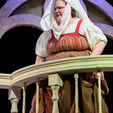
John Newman
INCLUSIVE PRODUCTION OF ROMEO & JULIET
ACTOR NEEDS:
Actor cast as Nurse is Deaf and communicates primarily in ASL; needs a way to communicate with the Hearing actors/characters

Slide 16
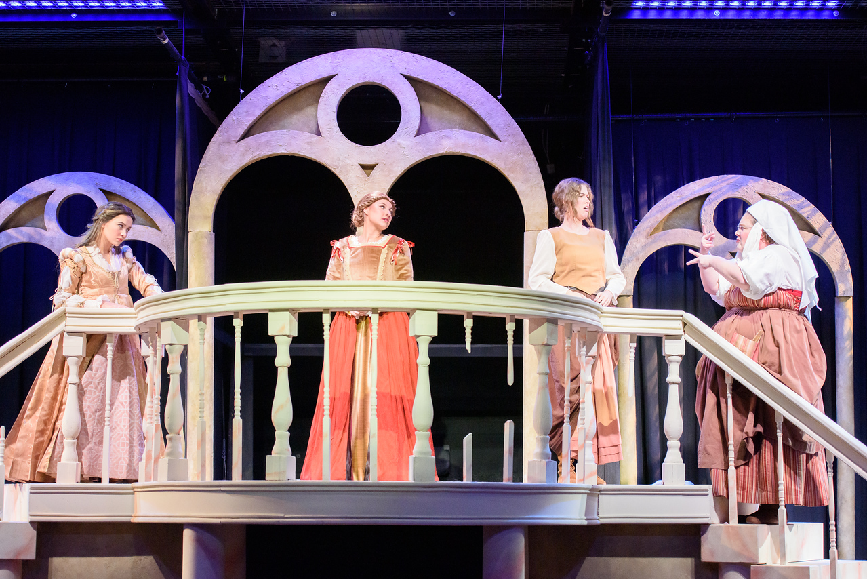
John Newman
INCLUSIVE PRODUCTION OF ROMEO & JULIET
ACCOMODATIONS
Script adapted so two servants interpreted for Nurse (first reading rough, figured out script by 1st rehearsal)
“World of the Play” changed so that the nobility learned sign rather than Latin (Romeo loves showing off his signing to the Nurse)

Slide 17
John Newman
INCLUSIVE PRODUCTION OF ROMEO & JULIET
ACCOMMODATIONS
Juliet signed to Nurse, voiced Nurses lines to maintain their secrets
Lady Capulet used simple signs with the Nurse

Slide 18
John Newman
INCLUSIVE PRODUCTION OF ROMEO & JULIET
ACCOMMODATIONS
Lord Capulet refuses to use sign language with the nurse…
…but does so in the epilogue, promising that she will always have a place in his house.

Slide 19
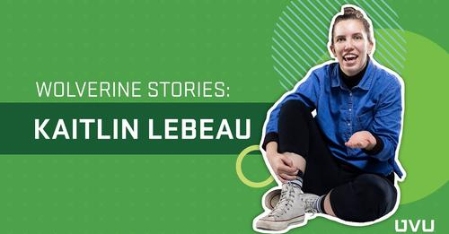
John Newman
INCLUSIVE PRODUCTION OF ROMEO & JULIET
ACCOMMODATION:
Student Assistant Director is a CODA and served as sign language coach, with the consent and in collaboration with the Deaf actor.
https://youtu.be/R-05rYXdpk8

Slide 20
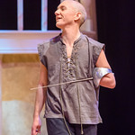
John Newman
INCLUSIVE PRODUCTION OF ROMEO & JULIET
ACTOR NEEDS:
Actor playing Balthasar has an amputated left arm
Actor struggles with sensory issues and overheating
Actor struggles with memorization
Actor has periodic depressive episodes

Slide 21
John Newman
INCLUSIVE PRODUCTION OF ROMEO & JULIET
ACCOMODATIONS
Balthasar used their weapon strapped to their forearm
Costuming had to be light, aerated, smooth surfaces while being historically plausible
Lines in Mantua scene were reduced and abridged script provided
Assistant director in costume could step on at a moment’s notice

Slide 22
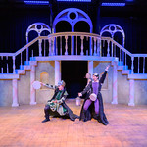
John Newman
INCLUSIVE PRODUCTION OF ROMEO & JULIET
MODELING FULL INCLUSION:
Cast multiple students with various manifestations of Autism
Cast as many BA/BS Ed students as BFA students
Casting more female actors than male actors
  Gender roles redefined for Mercutio, Lady Montague, Prince Escalus, Servants
  Role of Rosaline added, using lines from Friar John, Hermia, Rosalind

Slide 23
The Fries Test (2017) Kenny Fries & Sherri Smith highlighting (less than ideal) representation of characters with disabilities
  Does it have more than one disabled character?
  Do the disabled characters have their own narrative purpose other than the education and profit of a non-disabled character?
  Is the character’s disability not eradicated either by curing or killing?
  Additional Questions to Consider (National Disability Theatre)
  Do the disabled characters encounter conflicts or demonstrate characteristics unrelated to their disability?
  Do the disabled characters use their status, ability, and disability for positive and negative ends?
  Do the disabled characters both give and receive help from the non-disabled characters?
  How did the disabled community participate in the development, creation, and presentation of the play? (“Nothing About Us Without Us”)

Slide 24
Talleri McRee
LA JOLLA PLAYHOUSE PRODUCTION OF
EMILY DRIVER’S GREAT RACE THROUGH TIME & SPACE

Slide 25
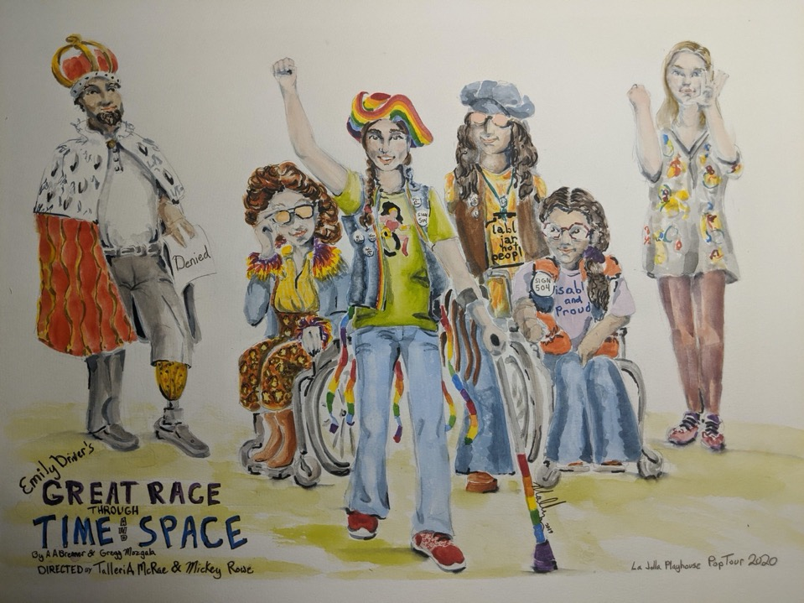



EMILY DRIVER’S GREAT RACE
THROUGH TIME AND SPACE
By A.A. Brenner and Gregg Mozgala
Costume Design by Mallory K Nelson
Notes:
The story: 12-year-old Emily Driver uses her YouTube channel to celebrate moments of activism and change. When her request for a needed wheelchair is denied, she time-travels across the country where she meets trailblazing leaders from the past who have fought for equal rights. Co-written by A.A. Brenner and Gregg Mozgala, “Emily Driver’s Great Race Through Time and Space” follows a young woman's journey as she learns the power of speaking up, and how one voice can help others to fight the forces of ableism and create a more just world. The play can be found on the New Play Exchange.

Slide 26
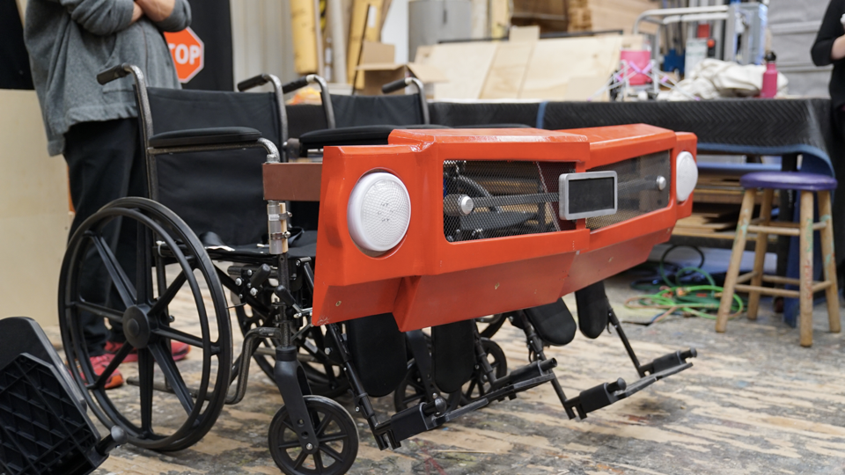
EMILY DRIVER’S GREAT RACE
THROUGH TIME AND SPACE
By A.A. Brenner and Gregg Mozgala
Scenic Design by Sean Fanning

Slide 27
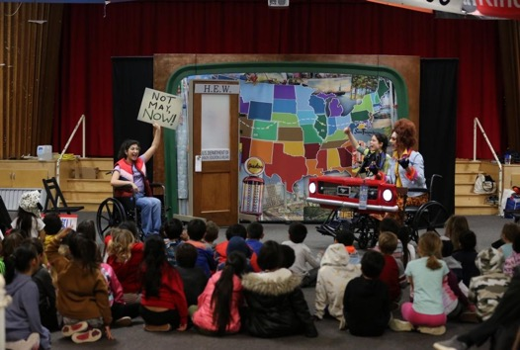
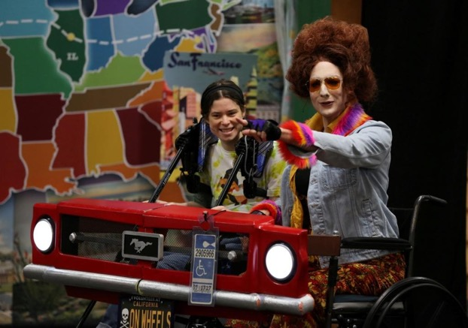
EMILY DRIVER’S GREAT RACE
THROUGH TIME AND SPACE
By A.A. Brenner and Gregg Mozgala

Slide 28
The Fries Test (2017) Kenny Fries & Sherri Smith highlighting (less than ideal) representation of characters with disabilities
  Does it have more than one disabled character?
  Do the disabled characters have their own narrative purpose other than the education and profit of a non-disabled character?
  Is the character’s disability not eradicated either by curing or killing?
  Additional Questions to Consider (National Disability Theatre)
  Do the disabled characters encounter conflicts or demonstrate characteristics unrelated to their disability?
  Do the disabled characters use their status, ability, and disability for positive and negative ends?
  Do the disabled characters both give and receive help from the non-disabled characters?
  How did the disabled community participate in the development, creation, and presentation of the play? (“Nothing About Us Without Us”)

Slide 29
Group Brainstorming:
Good, Better, Best Presentation of Disabled Characters
CHOOSE A FAMILIAR STORY THAT COULD BE PRESENTED ON STAGE.
CONSIDER HOW THE STORY HAS BEEN PRESENTED IN THE PAST
Which character(s) may be considered disabled or may be presented as such?
Which character(s), traditionally presented as non-disabled, might manifest a disability?
C. BRAINSTORM HOW WE ARE GOING TO PRESENT THE STORY ON STAGE:
1. What are the characters? What are their gifts, talents, barriers and challenges?
2. Who are the artists? What are their identities, including abilities and disabilities? How are they typically portrayed in dominant culture?
3. How might the qualities of the characters be matched with the identities of the artists?
4. How might disabled community members participate in the development, creation, and presentation of the play?

Slide 30
Closure
Contact information of panelists
  John Newman, john.newman@uvu.edu
  Talleri McRae, talleri.a.mcrae@gmail.com
  Jeff Jenkins, jjenkins@northwestern.edu
Reminder of resources in PowerPoint
  National Disability Theatre handbook
  Video link to Timmon and the Magic Shoes
  Video link to CODA student video
AATE Announcements

